Slide 1
Vaccinations

Slide 2
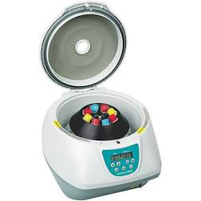
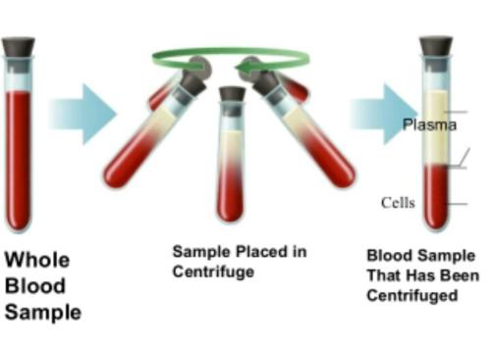

Slide 3
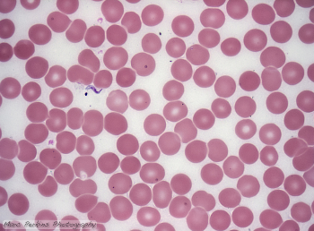
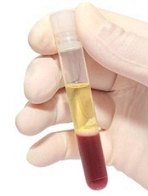
Liquid - Plasma
White blood cells and platelets
Red blood cells

Slide 4
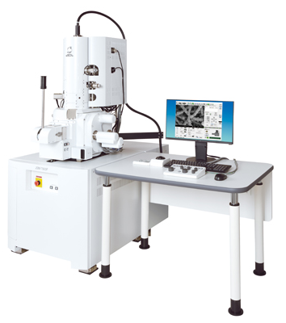
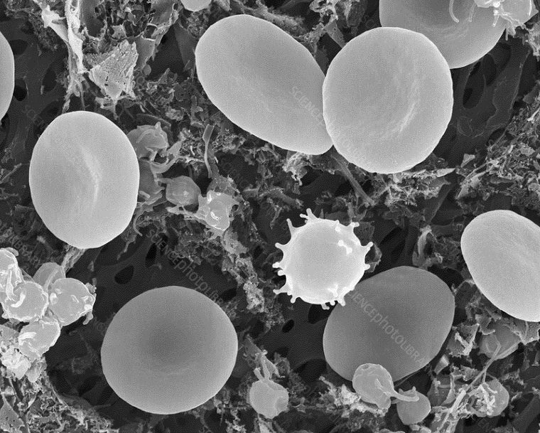
Red Cell
White cell

Slide 5
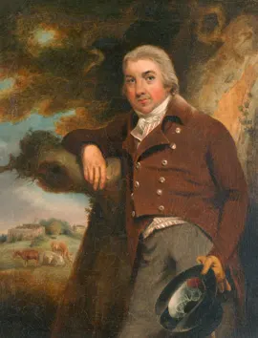
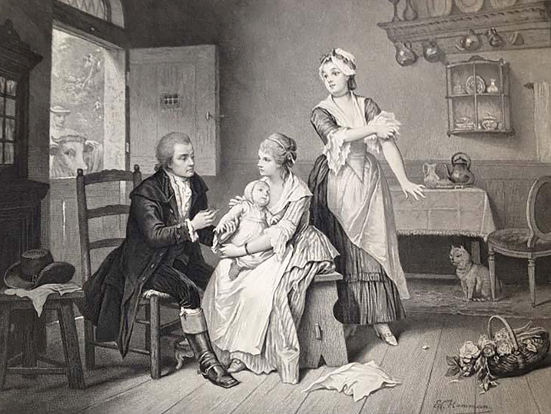
“Cow” in Latin is vacca
Edward Jenner 1749 - 1843

Slide 6
Smallpox kills 1 in 3 of the people it infects.
During the 20th Century, smallpox killed about 300 million people
Smallpox was killing 15 million people around the world per year by 1967
The World Health Organisation launched a mass vaccination programme and no more cases of smallpox were found by 1980. The WHO declared, “smallpox is dead”.
Today, for research, 2 samples of smallpox still exist. One in the USA and one in Russia. They are guarded more heavily anything in the world.

Slide 7
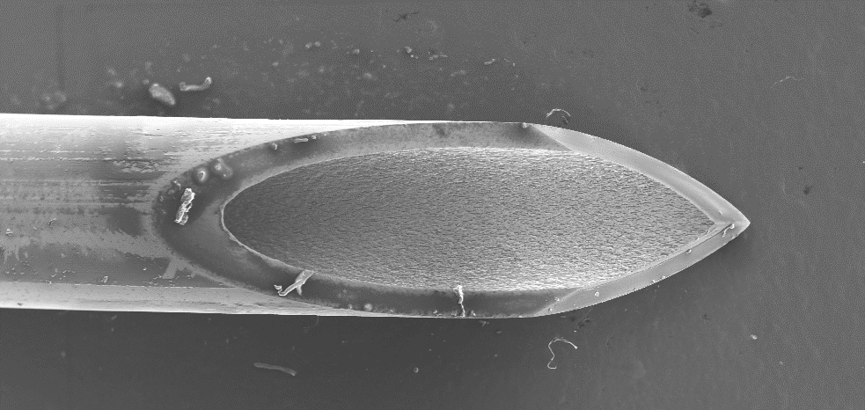
Why are vaccinations usually injected into people?

